Slide 1
Data-driven Decision Making
Emanuele Della Valle
Prof. @ Politecnico di Milano & Partner @ Quantia Consulting
Marco Balduini
Founder & CEO @ Quantia Consulting

Slide 2
What are they? Time Series

Slide 3
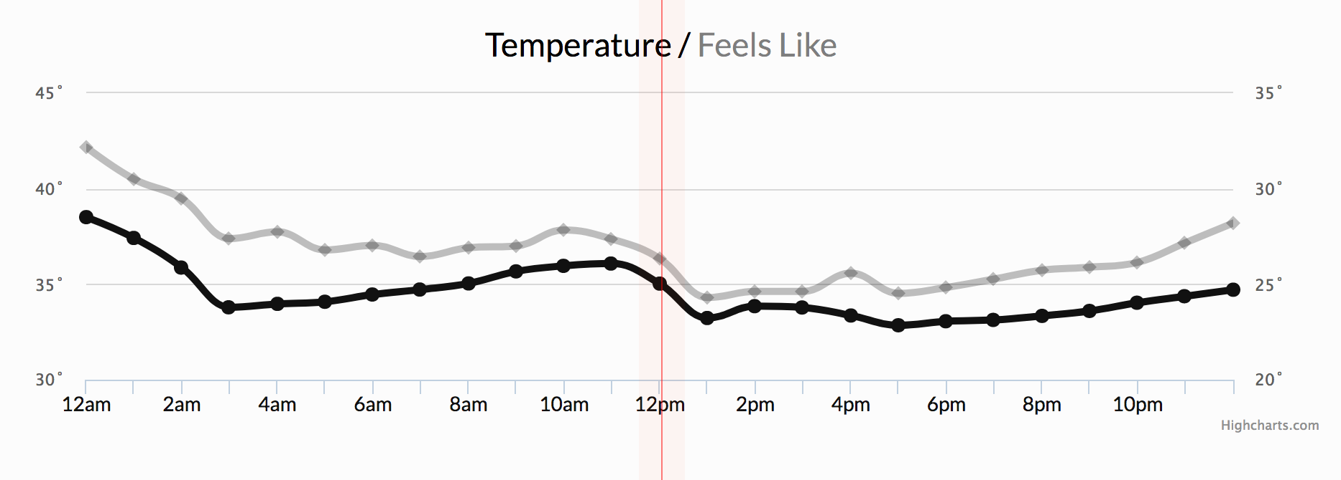
Let’s start by example
Weather conditions
Notes:
33

Slide 4
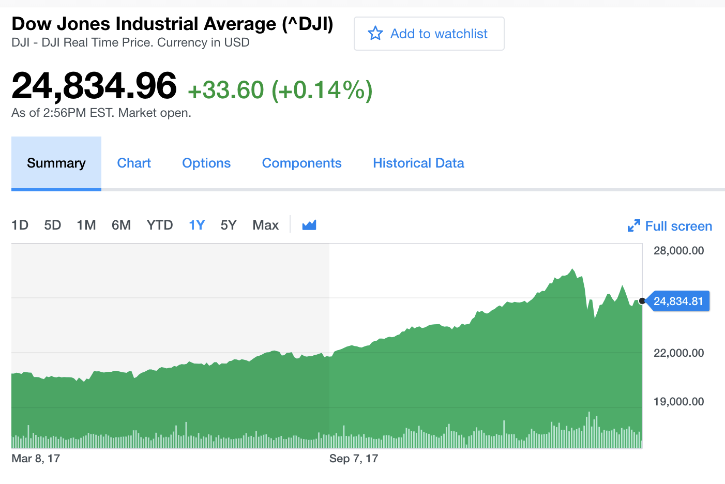
Let’s start by example
Weather conditions
Stock exchange
Notes:
44

Slide 5
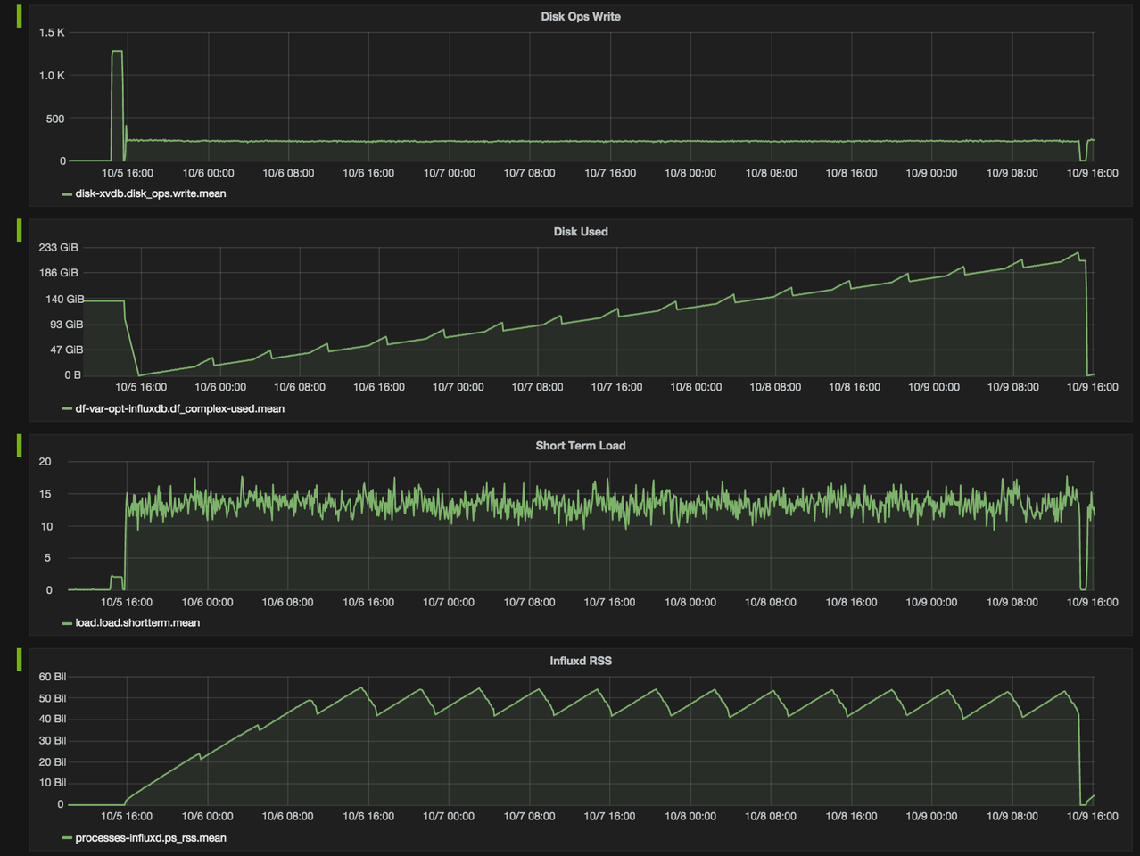
Let’s start by example
Weather conditions
Stock exchange
Cluster monitoring
Notes:
55

Slide 6
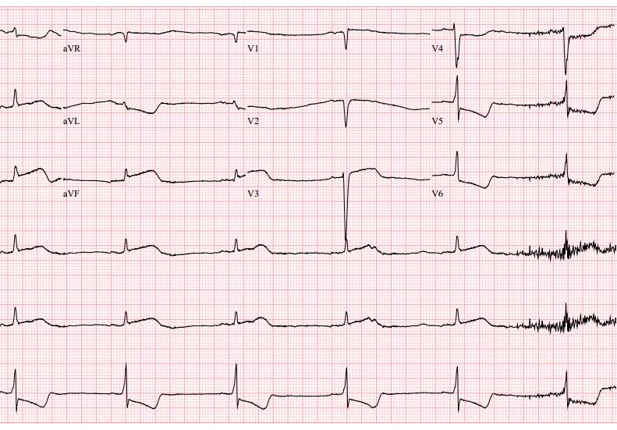
Let’s start by example
Weather conditions
Stock exchange
Cluster monitoring
Healthcare
Notes:
66

Slide 7
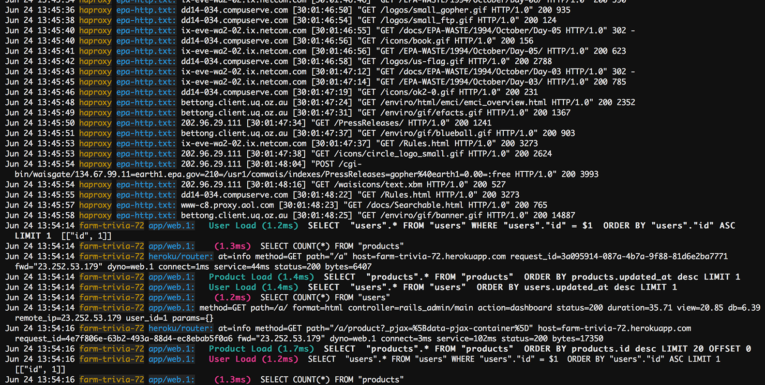
Now something different
Logs
Notes:
77

Slide 8
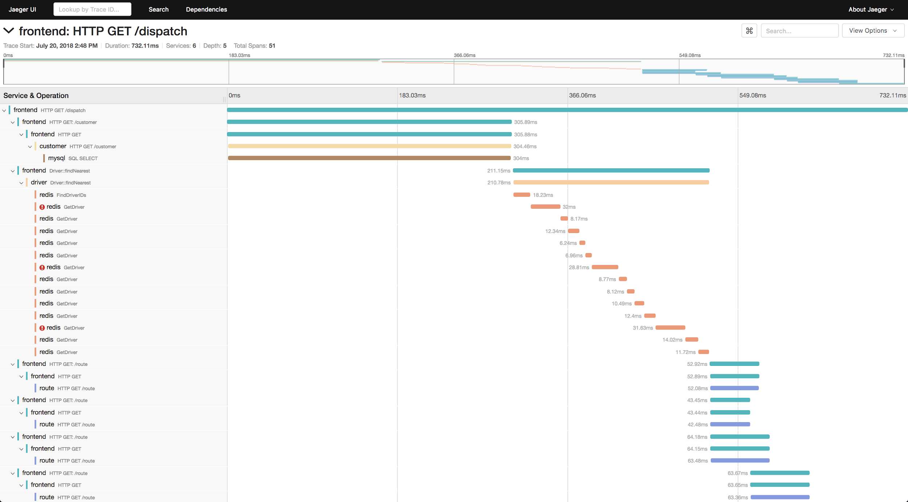
What’s the difference?
Logs
Traces
Notes:
88

Slide 9
What’s the difference?
VS.

Slide 10
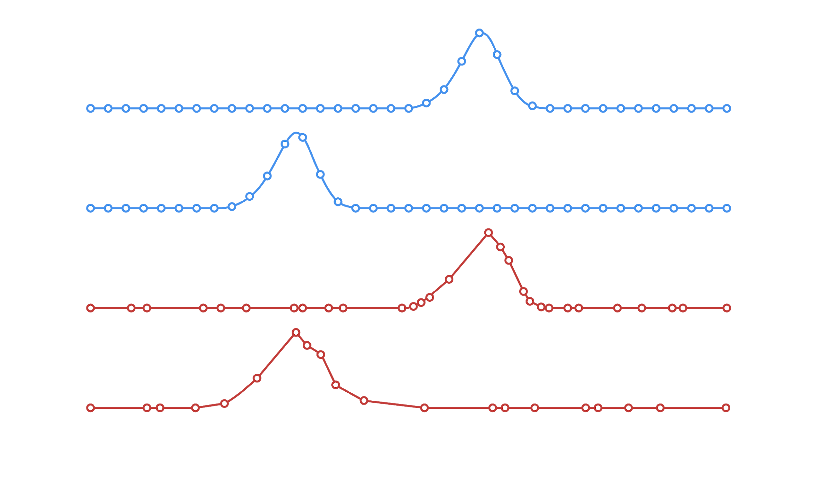
What’s the difference?
both of them are time series, but …
We monitor the phenomena
The phenomena happen and we observe them
regular
irregular
VS.
metrics
events

Slide 11

Metrics
Events
Regular Time Series
Irregular Time Series
Measurements gathered at regular time intervals
Measurements observed at irregular time intervals

Slide 12
Summarization of Events
Events become regular time intervals, for example
Summarizing the average trade price of Apple stock every 10 minutes over the course of a day
Summarizing the average response time for requests in an application over 1 minute intervals

Slide 13
Who uses them and how? Time Series

Slide 14
Primary Use Cases
IoT
DevOps
Real-Time Analytics
Industrial settings: factories, oil & gas, agriculture, smart roads & infrastructure
Consumer: wearables, consumer devices & trackers
Custom monitoring solutions to track servers, VMs, applications, users or events
Apps that instrument business, social or development metrics in real-time

Slide 15

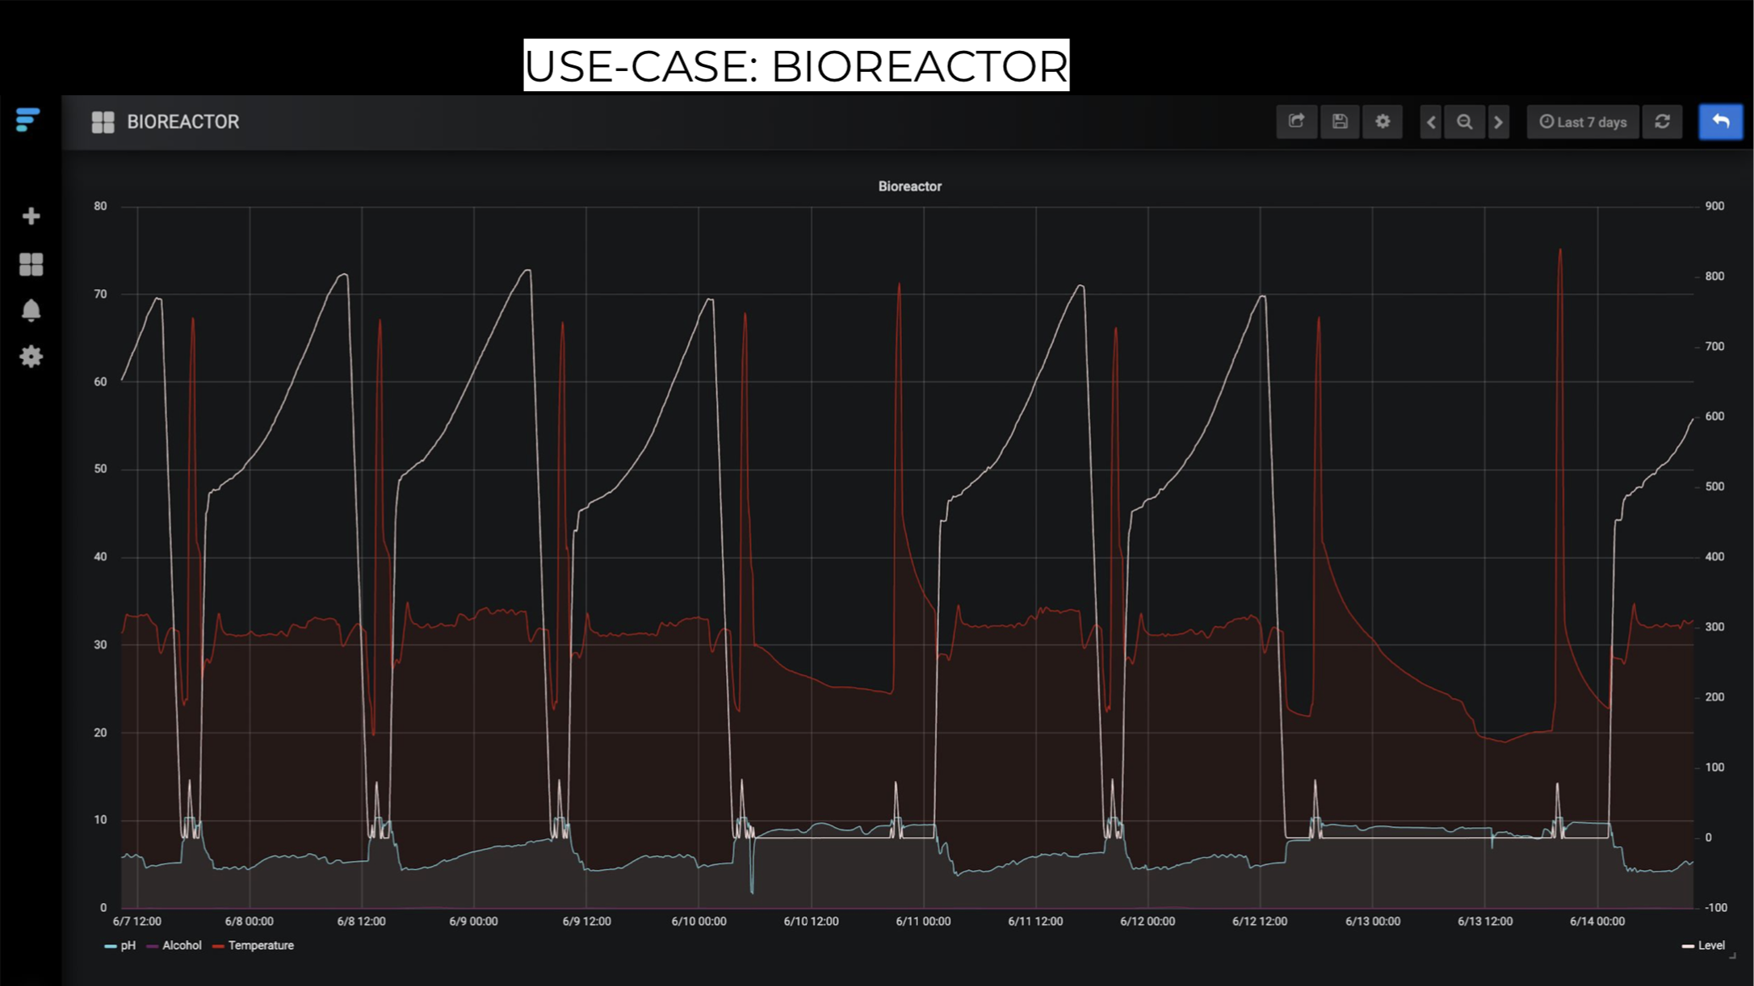

Slide 16
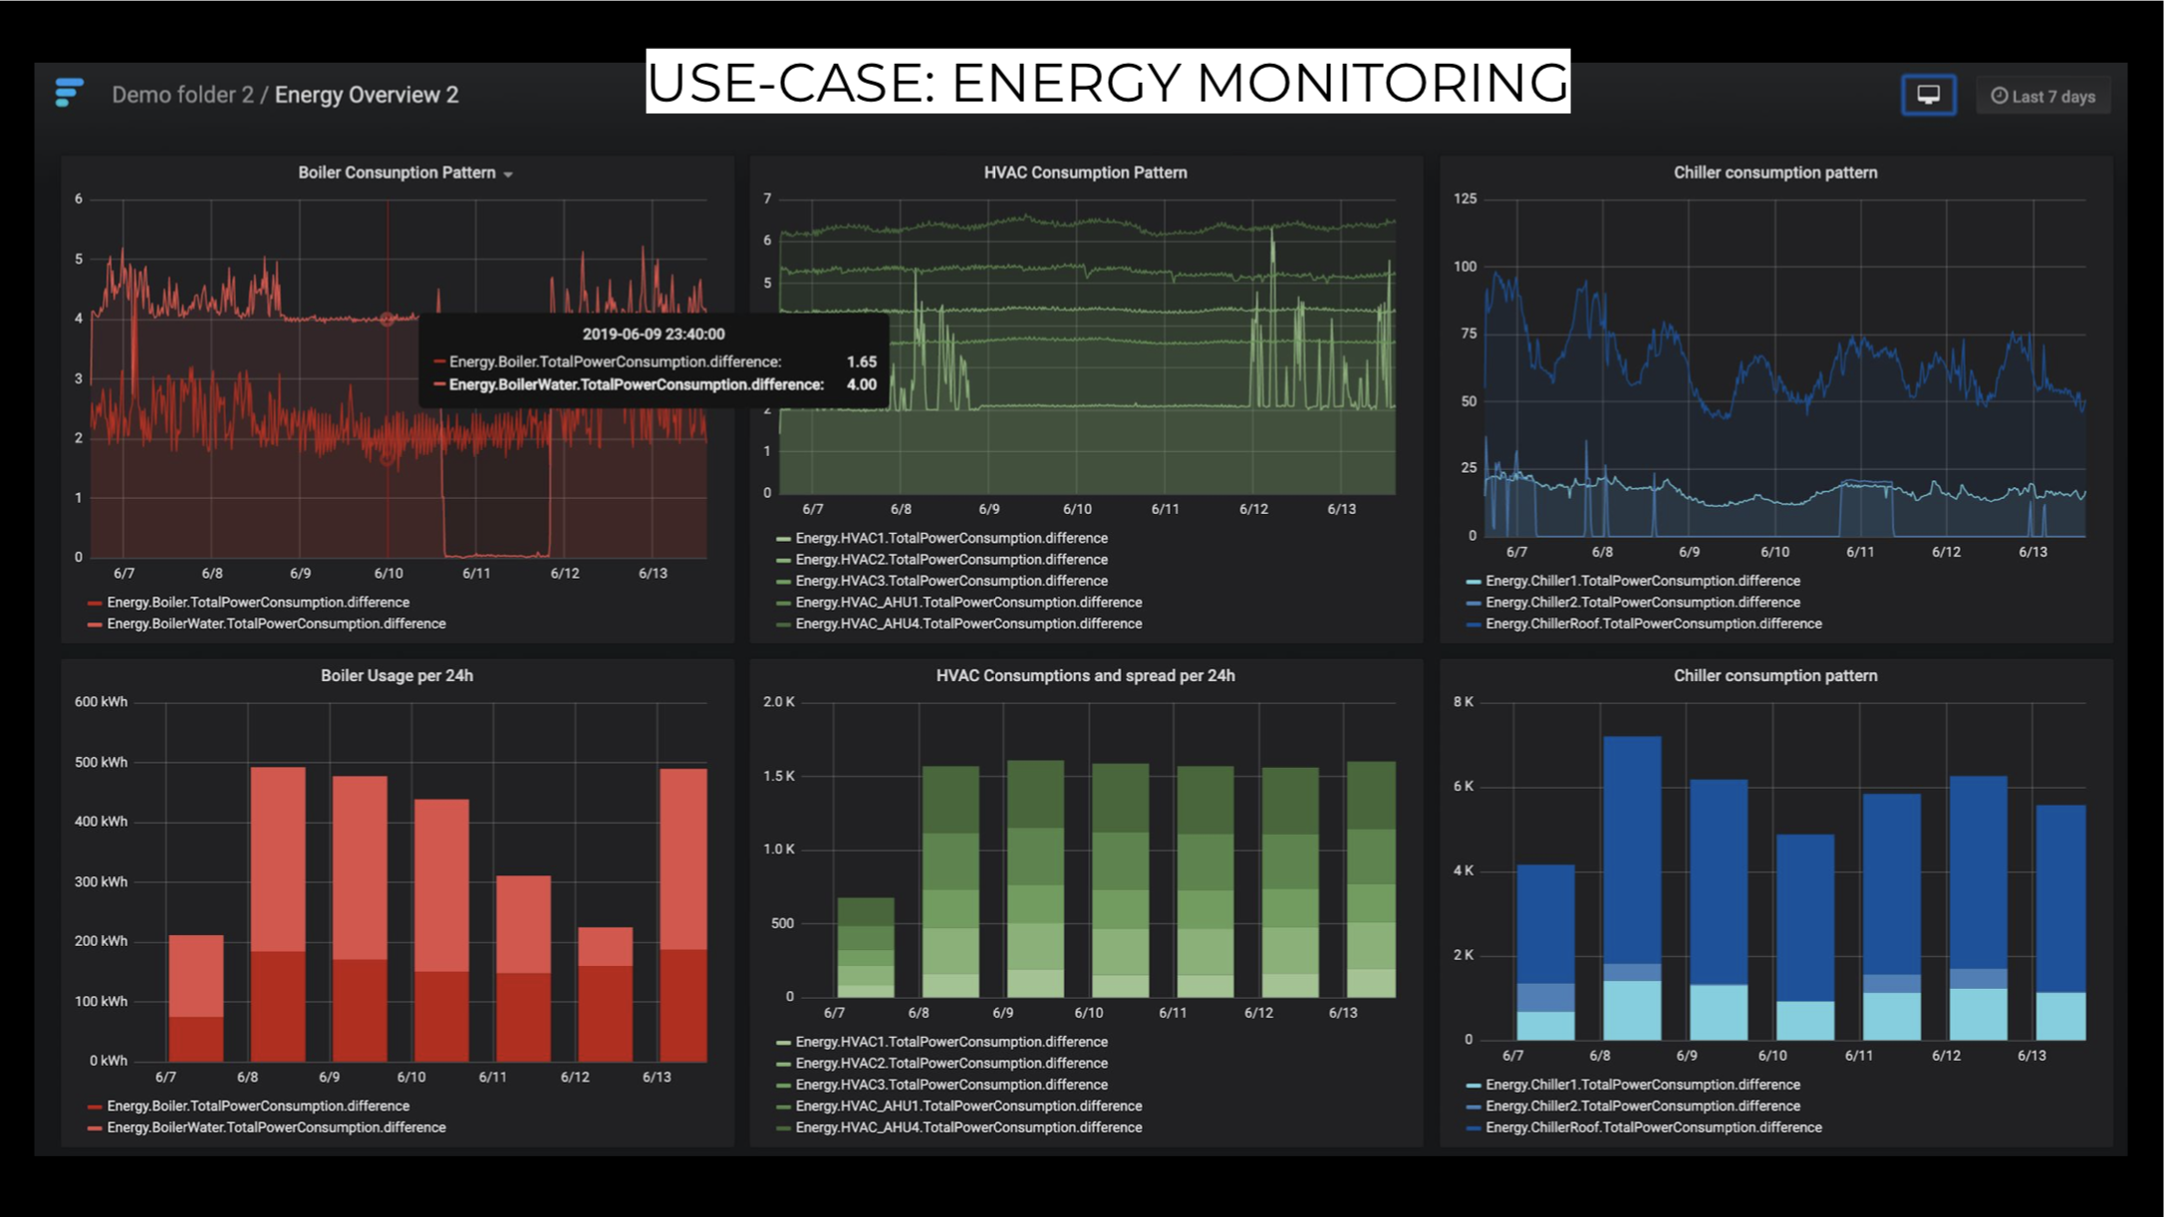

Slide 17
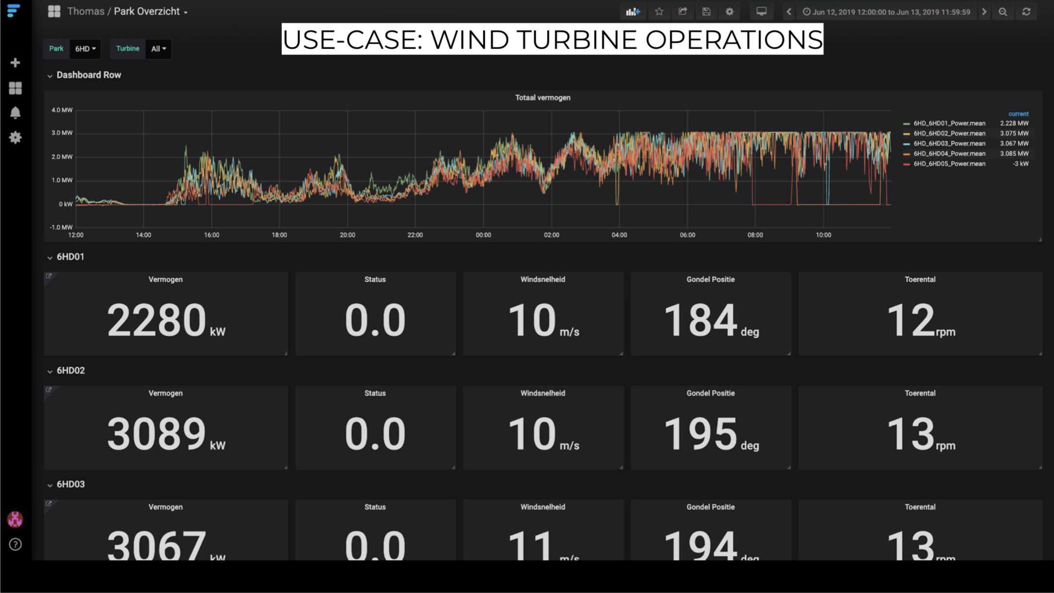

Slide 18
Back to the nature of time series … Time Series

Slide 19
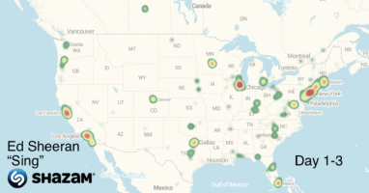
Question: Time-Series?
yes
no
Data items of time series can be complex and semi-structured …

Slide 20
Characteristics of the time series
All Time-stamped data
Generated in
regular (Metric) and
irregular (Event) time periods
Huge volumes of data
High variety of semi-structured data
Real-time
Time sensitive

Slide 21
So what’s a time series DB? Time Series

Slide 22
Time series DB
Other DBs
Traditional relational Databases optimized for storing and querying structured data
Document databases Optimized for storing and retrieving semi-structured JSON documents
Search databases Optimized for storing and retrieving unstructured data (e.g., full-text searches)
optimized for
collecting
storing
retrieving
processing (historical and real-time)
timestamped & semi-structured data

Slide 23
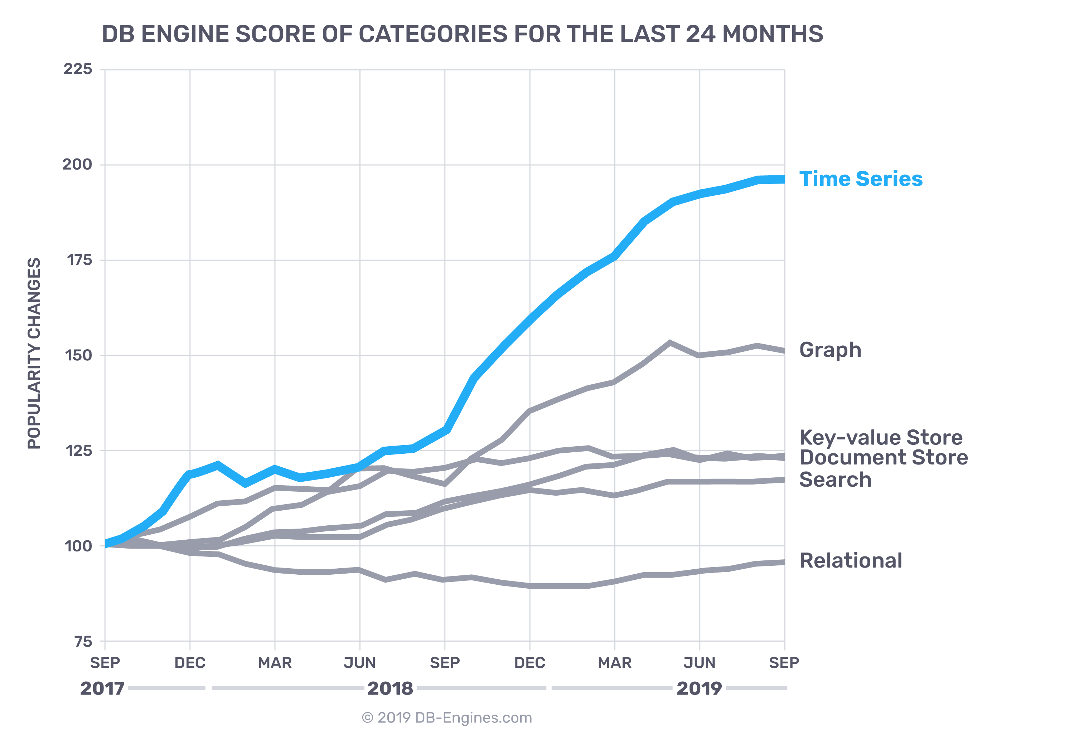
The interest about time series data bases is growing
https://db-engines.com/en/ranking_categories

